Slide 1

CHAPTER 9
COUNTING AND
PROBABILITY
Copyright © Cengage Learning. All rights reserved.

Slide 2
SECTION 9.2
Possibility Trees and the Multiplication Rule
Copyright © Cengage Learning. All rights reserved.

Slide 3
Possibility Trees and the Multiplication Rule
A tree structure is a useful tool for keeping systematic track of all possibilities in situations in which events happen in order.
The next example shows how to use such a structure to count the number of different outcomes of a tournament.

Slide 4
Example 1 – Possibilities for Tournament Play
Teams A and B are to play each other repeatedly until one wins two games in a row or a total of three games.
One way in which this tournament can be played is for A to win the first game, B to win the second, and A to win the third and fourth games. Denote this by writing A–B–A–A.
a. How many ways can the tournament be played?
b. Assuming that all the ways of playing the tournament are
equally likely, what is the probability that five games are
needed to determine the tournament winner?

Slide 5
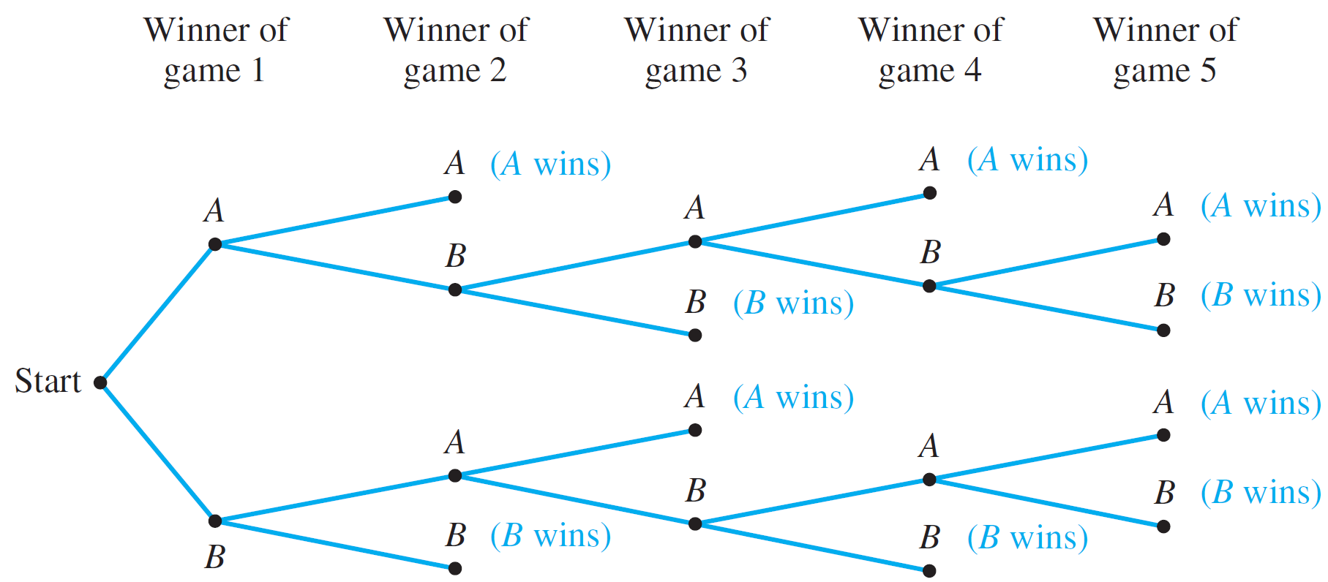
Example 1(a) – Solution
The possible ways for the tournament to be played are represented by the distinct paths from “root” (the start) to “leaf” (a terminal point) in the tree shown sideways in Figure 9.2.1.
The Outcomes of a Tournament
Figure 9.2.1

Slide 6
Example 1(a) – Solution
cont’d
The label on each branching point indicates the winner of the game. The notations in parentheses indicate the winner of the tournament.
The fact that there are ten paths from the root of the tree to its leaves shows that there are ten possible ways for the tournament to be played.
They are (moving from the top down): A–A, A–B–A–A,
A–B–A–B–A, A–B–A–B–B, A–B–B, B–A–A, B–A–B–A–A,
B–A–B–A–B, B–A–B–B, and B–B.
In five cases A wins, and in the other five B wins. The least number of games that must be played to determine a winner is two, and the most that will need to be played is five.

Slide 7
Example 1(b) – Solution
cont’d
Since all the possible ways of playing the tournament listed in part (a) are assumed to be equally likely, and the listing shows that five games are needed in four different cases (A–B–A–B–A, A–B–A–B–B, B–A–B–A–B, and
B–A–B–A–A), the probability that five games are needed is
4/10 = 2/5
= 40%.

Slide 8
The Multiplication Rule

Slide 9
The Multiplication Rule
Consider the following example. Suppose a computer installation has four input/output units (A, B, C, and D) and three central processing units (X, Y, and Z).
Any input/output unit can be paired with any central processing unit. How many ways are there to pair an input/output unit with a central processing unit?

Slide 10
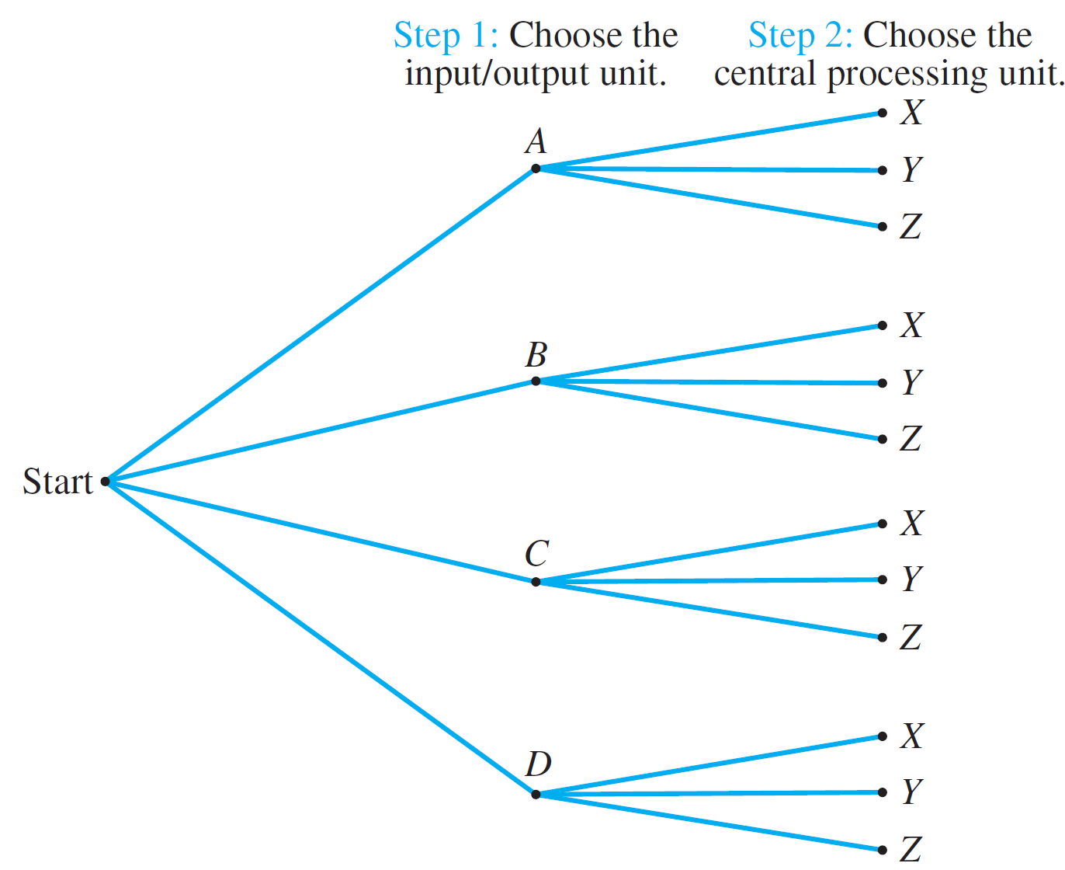
The Multiplication Rule
The possible outcomes of this operation are illustrated in the possibility tree of Figure 9.2.2.
Pairing Objects Using a Possibility Tree
Figure 9.2.2

Slide 11
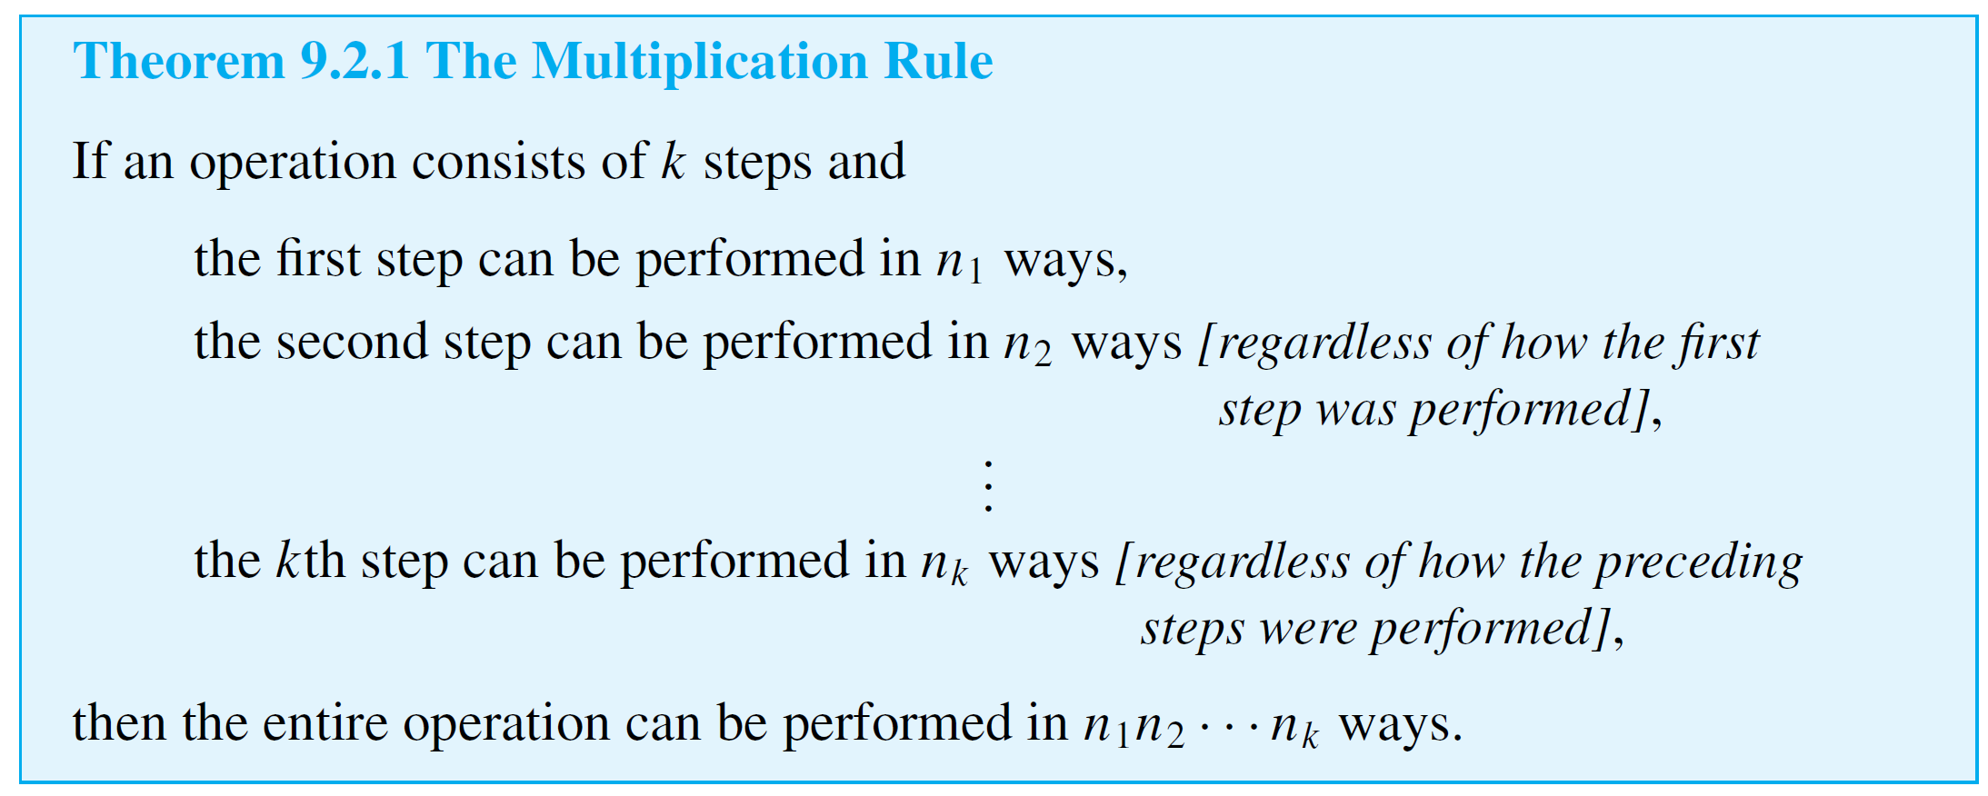
The Multiplication Rule
Thus the total number of ways to pair the two types of units is the same as the number of branches of the tree, which is
3 + 3 + 3 + 3 = 4  3 = 12.
The idea behind this example can be used to prove the following rule.

Slide 12
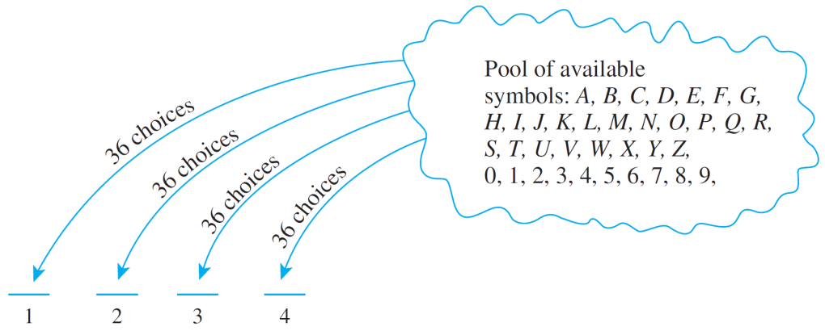
Example 2 – Number of Personal Identification Numbers (PINs)
A typical PIN (personal identification number) is a sequence of any four symbols chosen from the 26 letters in the alphabet and the ten digits, with repetition allowed. How many different PINs are possible?
Solution:
Typical PINs are CARE, 3387, B32B, and so forth.
You can think of forming a
PIN as a four-step
operation to fill in each
of the four symbols in
sequence.

Slide 13
Example 2 – Solution
cont’d
Step 1: Choose the first symbol.
Step 2: Choose the second symbol.
Step 3: Choose the third symbol.
Step 4: Choose the fourth symbol.
There is a fixed number of ways to perform each step, namely 36, regardless of how preceding steps were performed.
And so, by the multiplication rule, there are
36  36  36  36 = 36⁴ = 1,679,616 PINs in all.

Slide 14
Example 4 – Number of PINs without Repetition
In Example 2 we formed PINs using four symbols, either letters of the alphabet or digits, and supposing that letters could be repeated. Now suppose that repetition is not allowed.
a. How many different PINs are there?
b. If all PINs are equally likely, what is the probability that a
PIN chosen at random contains no repeated symbol?
Solution:
a. Again think of forming a PIN as a four-step operation:
Choose the first symbol, then the second, then the third,
and then the fourth.

Slide 15
Example 4 – Solution
cont’d
There are 36 ways to choose the first symbol, 35 ways to choose the second (since the first symbol cannot be used again), 34 ways to choose the third (since the first two symbols cannot be reused), and 33 ways to choose the fourth (since the first three symbols cannot be reused).
Thus, the multiplication rule can be applied to conclude that there are 36  35  34  33 = 1,413,720 different PINs with no repeated symbol.
b. By part (a) there are 1,413,720 PINs with no repeated symbol, and by Example 2 there are 1,679,616 PINs in all.

Slide 16
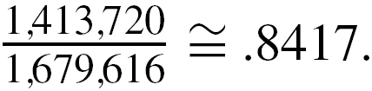
Example 4 – Solution
cont’d
Thus the probability that a PIN chosen at random
contains no repeated symbol is In other
words, approximately 84% of PINs have no repeated symbol.

Slide 17
The Multiplication Rule
We have known that if S is a nonempty, finite set of characters, then a string over S is a finite sequence of elements of S.
The number of characters in a string is called the length of the string. The null string over S is the “string” with no characters. It is usually denoted ε and is said to have length 0.

Slide 18
When the Multiplication Rule Is
Difficult or Impossible to Apply

Slide 19
When the Multiplication Rule Is Difficult or Impossible to Apply
Consider the following problem:
Three officers—a president, a treasurer, and a
secretary—are to be chosen from among four people: Ann, Bob, Cyd, and Dan. Suppose that, for various reasons, Ann cannot be president and either Cyd or Dan must be secretary. How many ways can the officers be chosen?
It is natural to try to solve this problem using the multiplication rule. A person might answer as follows:
There are three choices for president (all except Ann), three choices for treasurer (all except the one chosen as president), and two choices for secretary (Cyd or Dan).

Slide 20
When the Multiplication Rule Is Difficult or Impossible to Apply
Therefore, by the multiplication rule, there are 3  3  2 = 18 choices in all.
Unfortunately, this analysis is incorrect. The number of ways to choose the secretary varies depending on who is chosen for president and treasurer.
For instance, if Bob is chosen for president and Ann for treasurer, then there are two choices for secretary: Cyd
and Dan.
But if Bob is chosen for president and Cyd for treasurer, then there is just one choice for secretary: Dan.

Slide 21
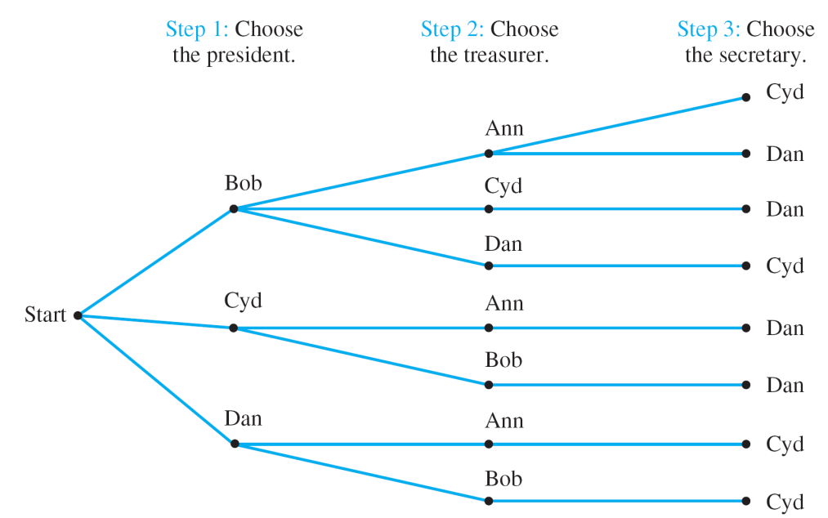
When the Multiplication Rule Is Difficult or Impossible to Apply
The clearest way to see all the possible choices is to construct the possibility tree, as is shown in Figure 9.2.3.
From the tree it is easy to see that there are only eight ways to choose a president, treasurer, and secretary so as to satisfy the given conditions.
Figure 9.2.3

Slide 22
Example 7 – A More Subtle Use of the Multiplication Rule
Reorder the steps for choosing the officers in the previous example so that the total number of ways to choose officers can be computed using the multiplication rule.
Solution:
Step 1: Choose the secretary.
Step 2: Choose the president.
Step 3: Choose the treasurer.

Slide 23
Example 7 – Solution
cont’d
There are exactly two ways to perform step 1 (either Cyd or Dan may be chosen), two ways to perform step 2 (neither Ann nor the person chosen in step 1 may be chosen but
either of the other two may), and two ways to perform step 3 (either of the two people not chosen as secretary or president may be chosen as treasurer).
Thus, by the multiplication rule, the total number of ways to choose officers is 2  2  2 = 8.

Slide 24
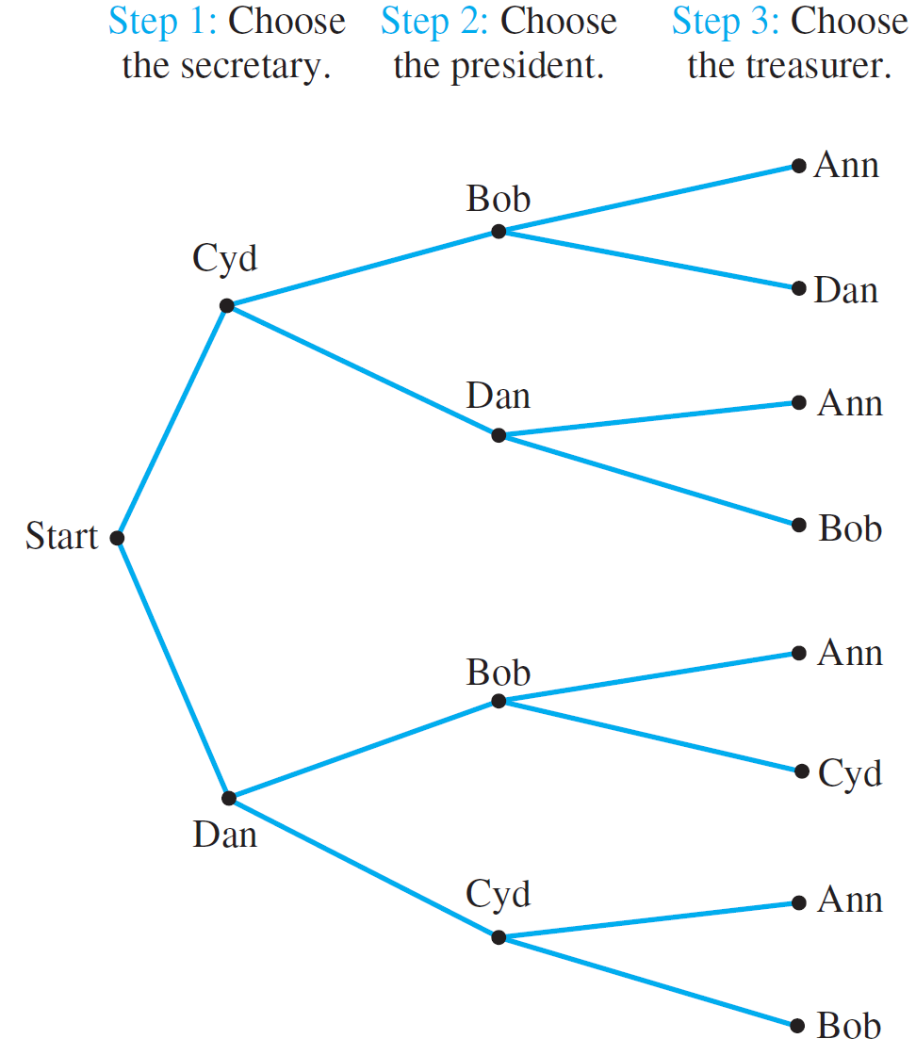
Example 7 – Solution
cont’d
A possibility tree illustrating this sequence of choices is shown in Figure 9.2.4.
Figure 9.2.4

Slide 25
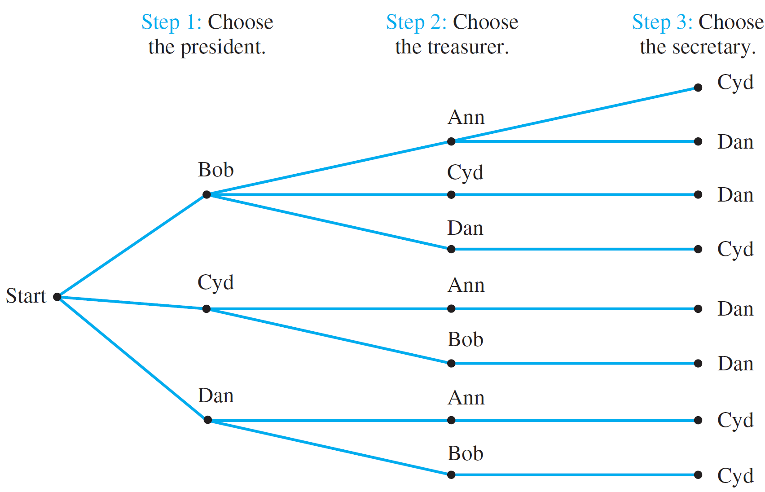
Example 7 – Solution
cont’d
Note how balanced the earlier tree in Figure 9.2.4 is compared with the one in Figure 9.2.3.
Figure 9.2.3

Slide 26
Permutations

Slide 27
Permutations
A permutation of a set of objects is an ordering of the objects in a row. For example, the set of elements a, b, and c has six permutations.
abc acb cba bac bca cab
In general, given a set of n objects, how many permutations does the set have? Imagine forming a permutation as an n-step operation:
Step 1: Choose an element to write first.

Slide 28

Permutations
Step 2: Choose an element to write second.
Step n: Choose an element to write nth.
Any element of the set can be chosen in step 1, so there are n ways to perform step 1.
Any element except that chosen in step 1 can be chosen in step 2, so there are n – 1 ways to perform step 2.

Slide 29
Permutations
In general, the number of ways to perform each successive step is one less than the number of ways to perform the preceding step.
At the point when the n th element is chosen, there is only one element left, so there is only one way to perform step n.
Hence, by the multiplication rule, there are
n(n – 1)(n – 2) · · · 2  1 = n!
ways to perform the entire operation.

Slide 30
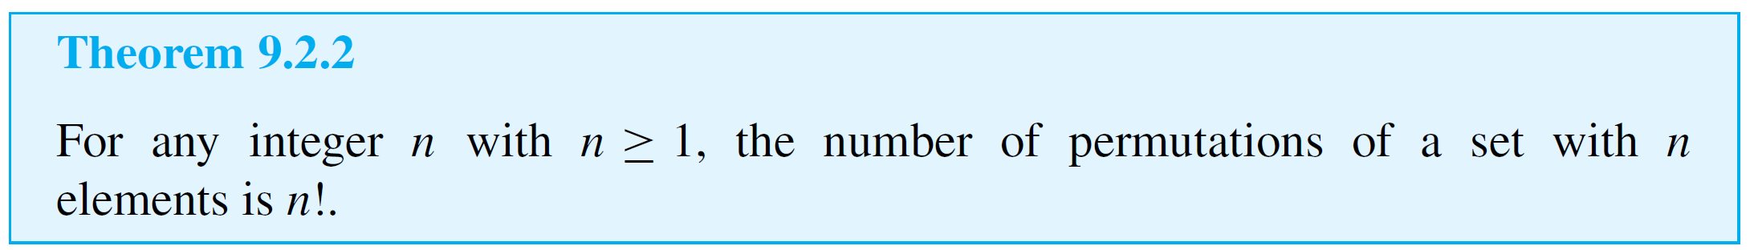
Permutations
In other words, there are n! permutations of a set of n elements. This reasoning is summarized in the following theorem.

Slide 31
Example 8 – Permutations of the Letters in a Word
a. How many ways can the letters in the word COMPUTER be arranged in a row?
b. How many ways can the letters in the word COMPUTER be arranged if the letters CO must remain next to each other (in order) as a unit?
c. If letters of the word COMPUTER are randomly arranged in a row, what is the probability that the letters CO remain next to each other (in order) as a unit?

Slide 32
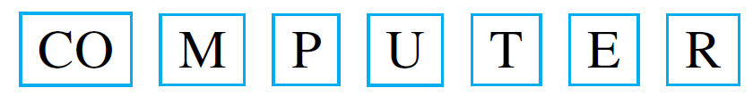
Example 8 – Solution
a. All the eight letters in the word COMPUTER are distinct, so the number of ways in which we can arrange the letters equals the number of permutations of a set of eight elements. This equals 8! = 40,320.
b. If the letter group CO is treated as a unit, then there are effectively only seven objects that are to be arranged in a row.
Hence there are as many ways to write the letters as there are permutations of a set of seven elements, namely 7! = 5,040.

Slide 33
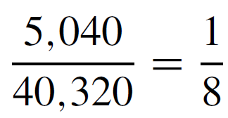

Example 8 – Solution
cont’d
c. When the letters are arranged randomly in a row, the total number of arrangements is 40,320 by part (a), and the number of arrangements with the letters CO next to each other (in order) as a unit is 5,040.
Thus the probability is

Slide 34
Permutations of Selected Elements

Slide 35
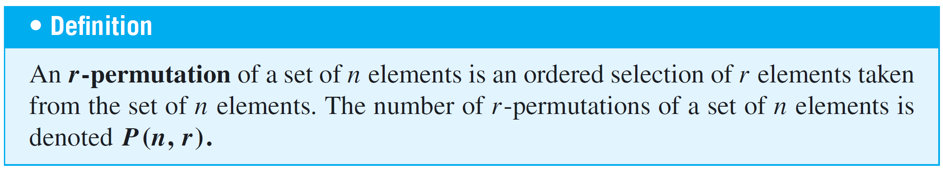
Permutations of Selected Elements
Given the set {a, b, c}, there are six ways to select two letters from the set and write them in order.
ab ac ba bc ca cb
Each such ordering of two elements of {a, b, c} is called a 2-permutation of {a, b, c}.

Slide 36
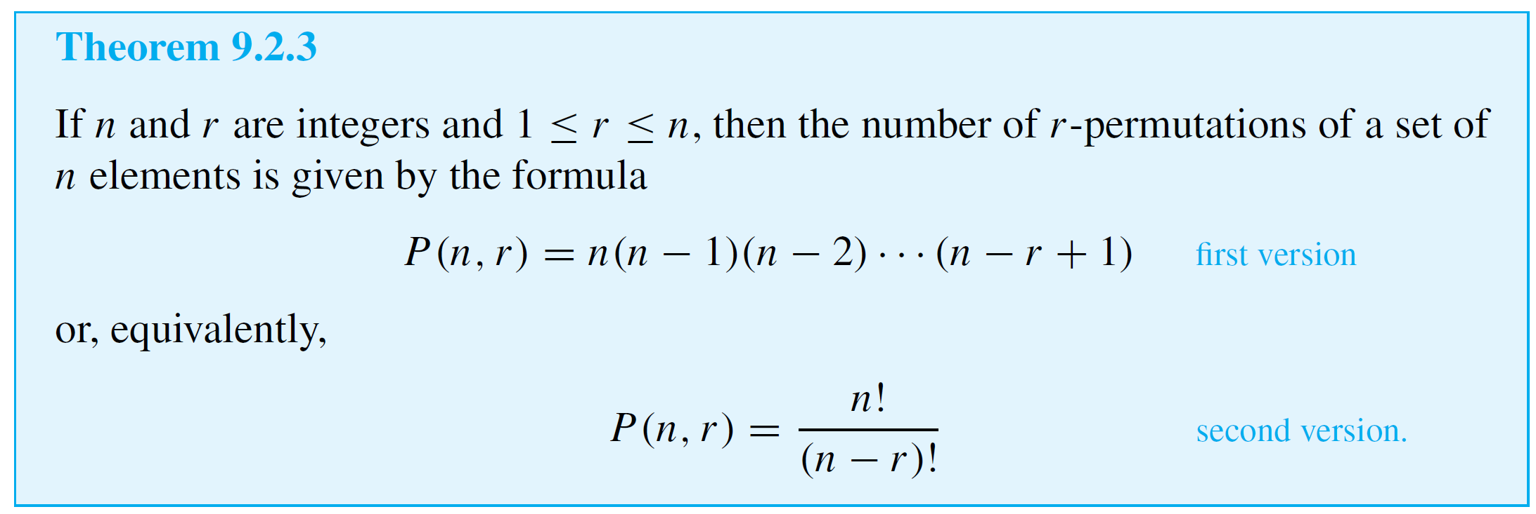
Permutations of Selected Elements

Slide 37
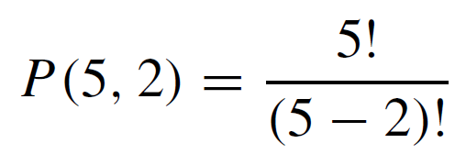
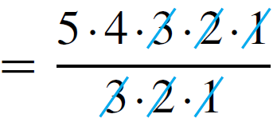

Example 10 – Evaluating r-Permutations
a. Evaluate P(5, 2).
b. How many 4-permutations are there of a set of seven objects?
c. How many 5-permutations are there of a set of five objects?
Solution:
a.

Slide 38
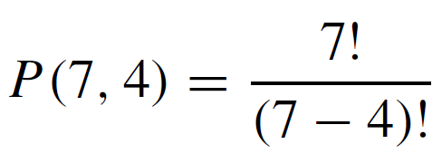
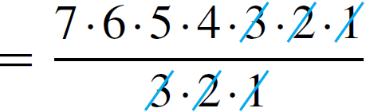


Example 10 – Solution
cont’d
b. The number of 4-permutations of a set of seven objects
is

Slide 39
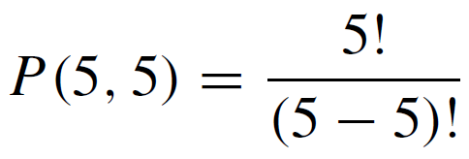
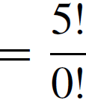
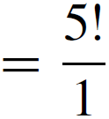


Example 10 – Solution
cont’d
c. The number of 5-permutations of a set of five objects is
Note that the definition of 0! as 1 makes this calculation come out as it should, for the number of 5-permutations of a set of five objects is certainly equal to the number of permutations of the set.

Slide 40
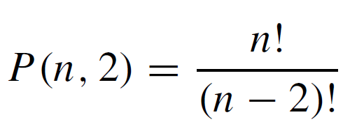
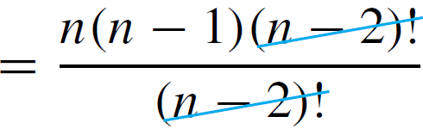
Example 12 – Proving a Property of P (n, r)
Prove that for all integers n ≥ 2,
P(n, 2) + P(n, 1) = n².
Solution:
Suppose n is an integer that is greater than or equal to 2.
By Theorem 9.2.3,

Slide 41

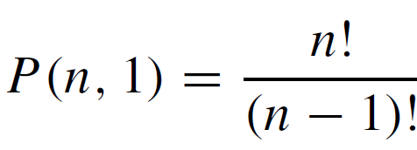
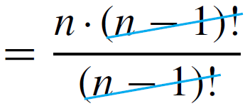



Example 12 – Solution
cont’d
and
Hence
which is what we needed to show.

